Slide 1

Carbon Footprint Manager
Denver James Duran

Slide 2
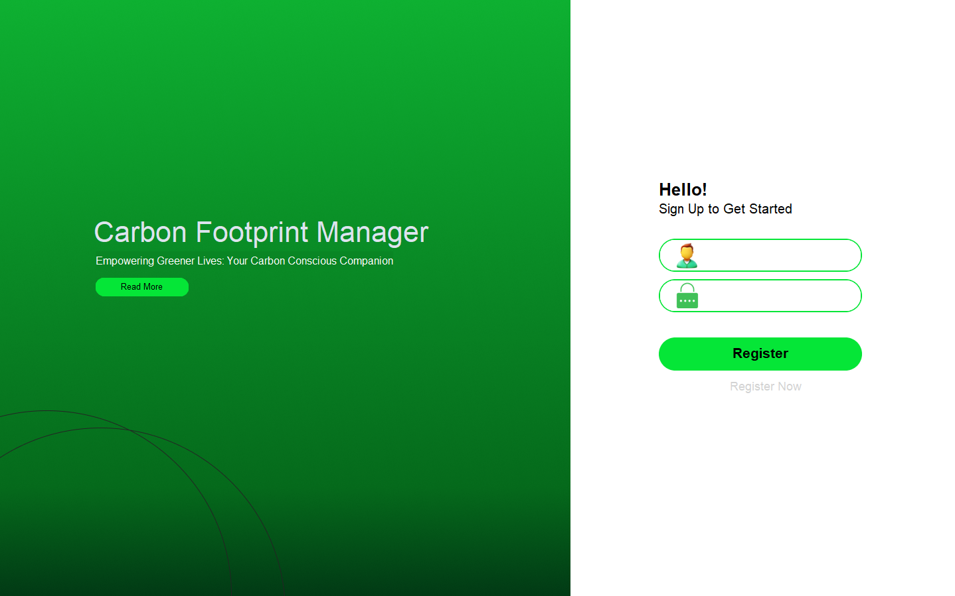

Slide 3
Username

Slide 4
Username
Password

Slide 5
Username
Password

Slide 6
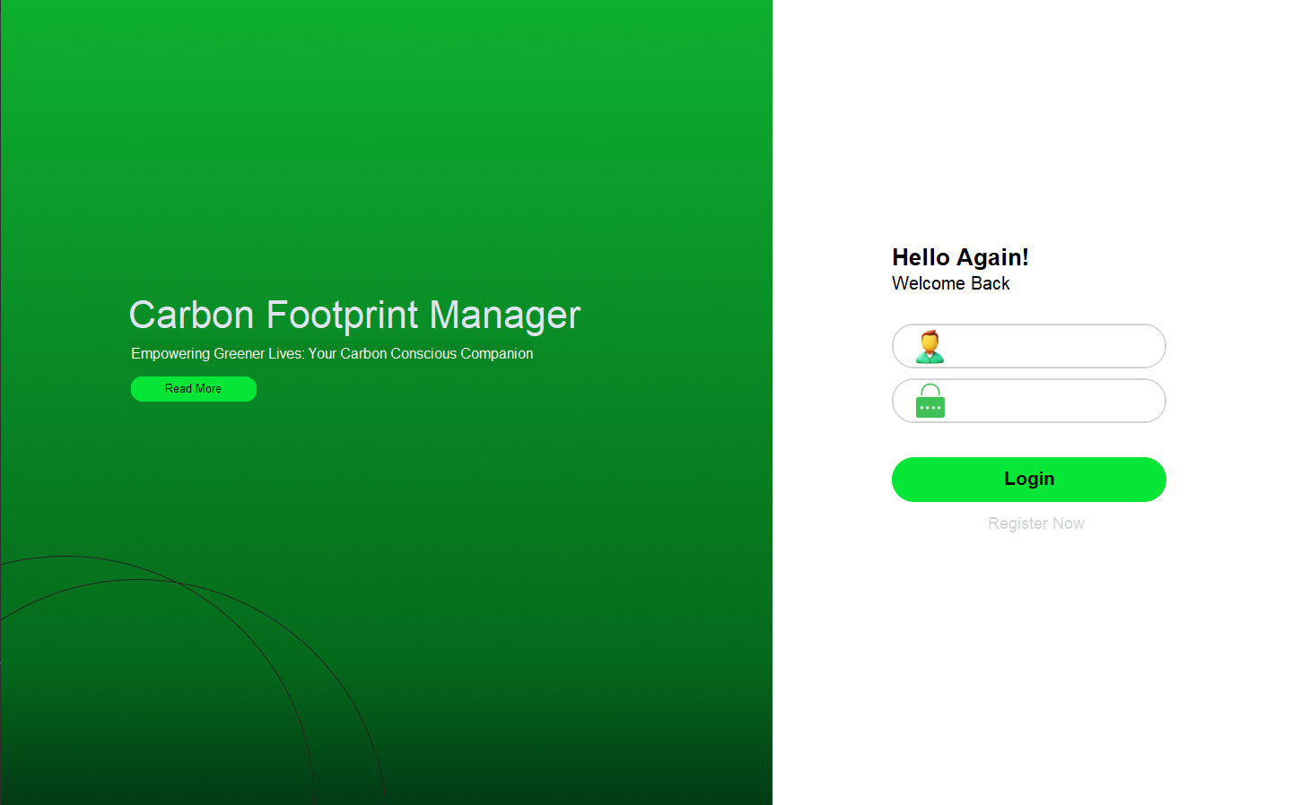

Slide 7
Username

Slide 8
Username
Password

Slide 9
Username
Password

Slide 10
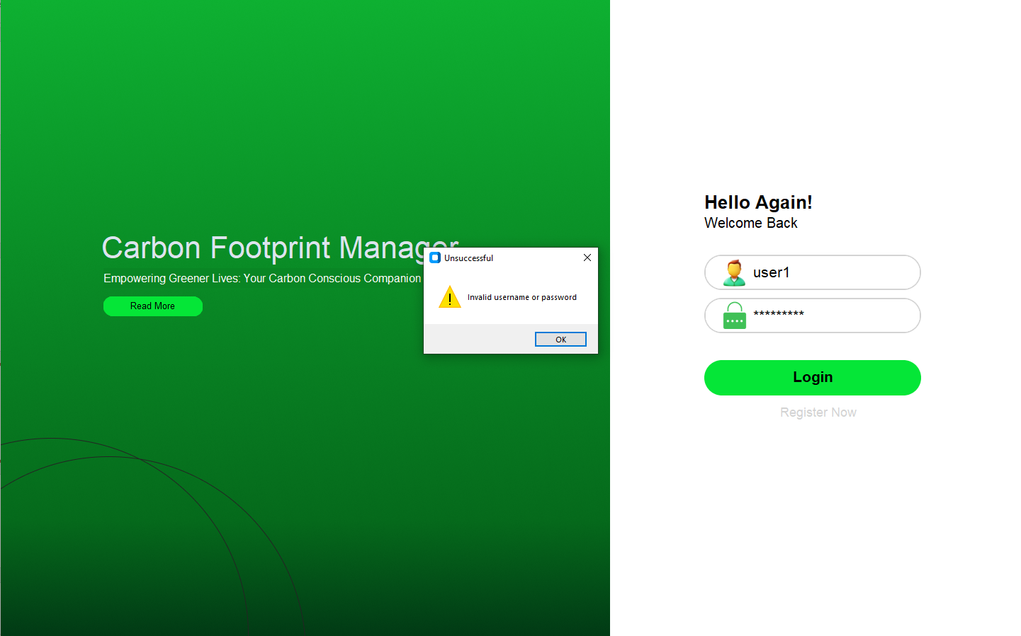

Slide 11
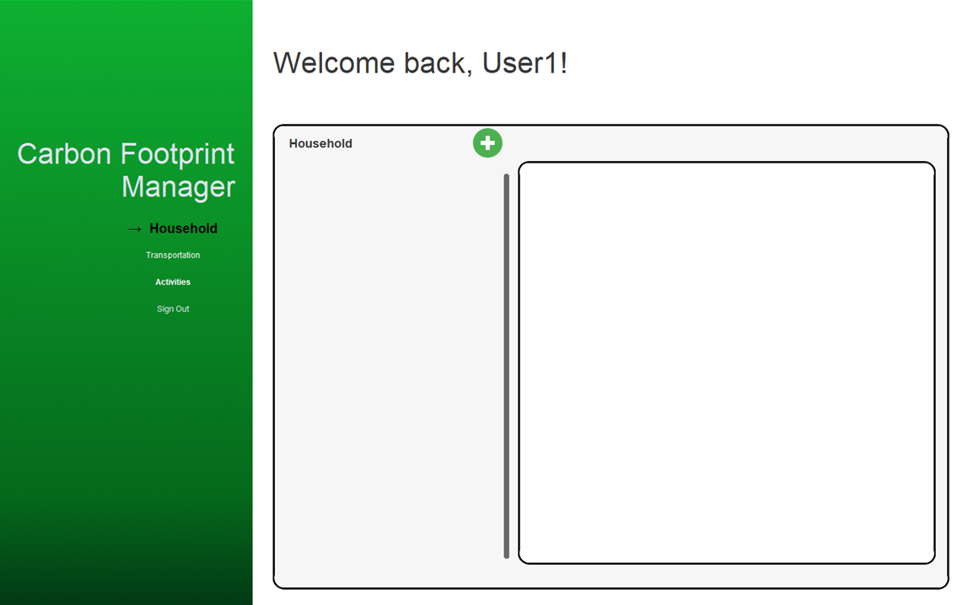

Slide 12
Select category here

Slide 13
Click to add activity
Select category here

Slide 14
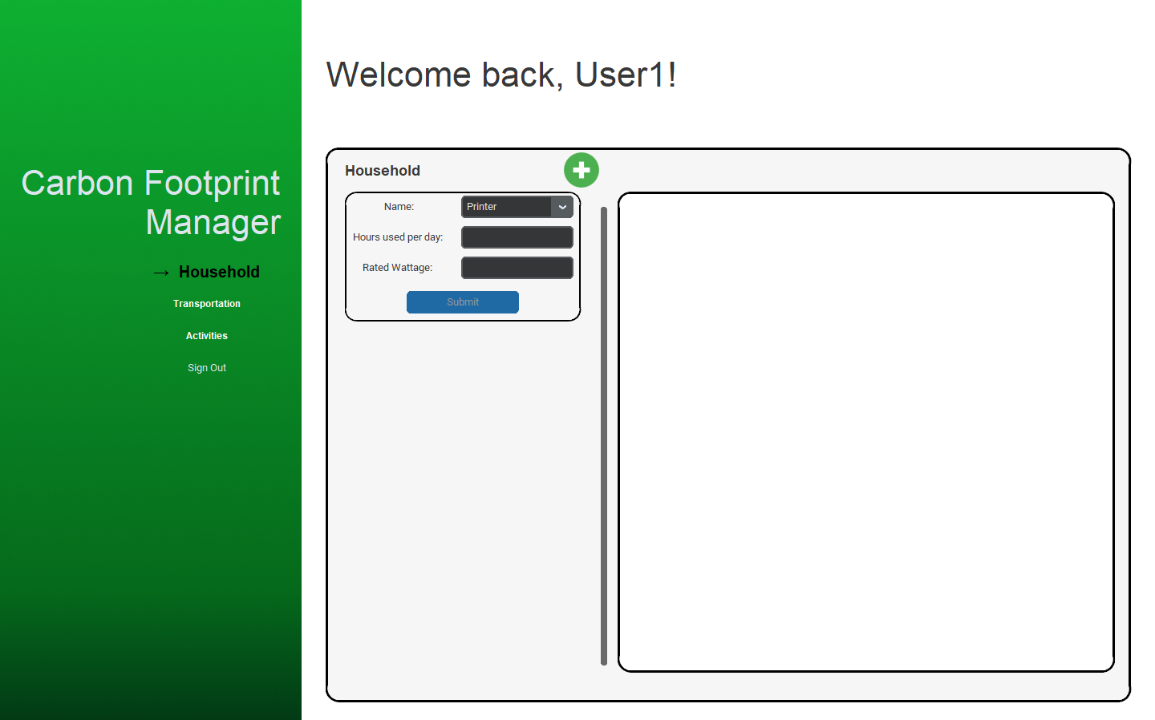
Click to add activity
Select category here

Slide 15
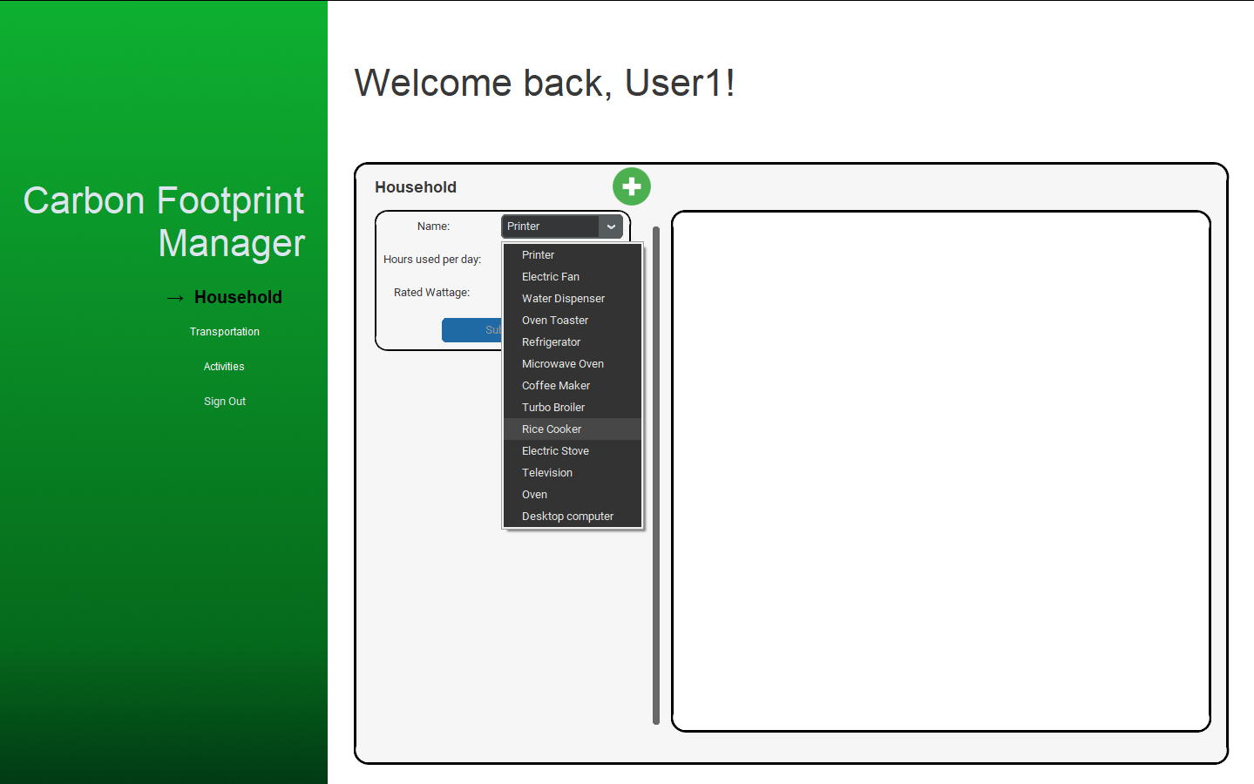
Click to add activity
Select category here

Slide 16


Slide 17
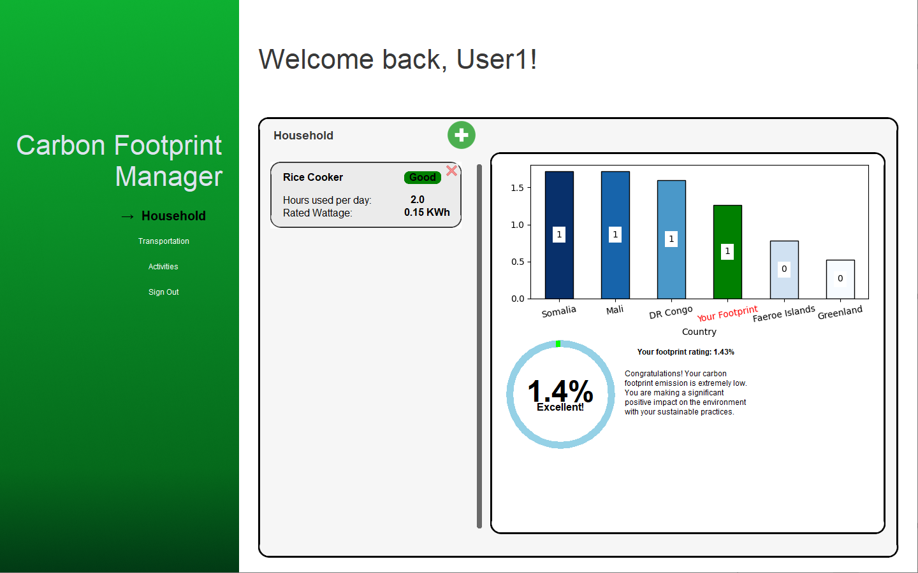

Slide 18
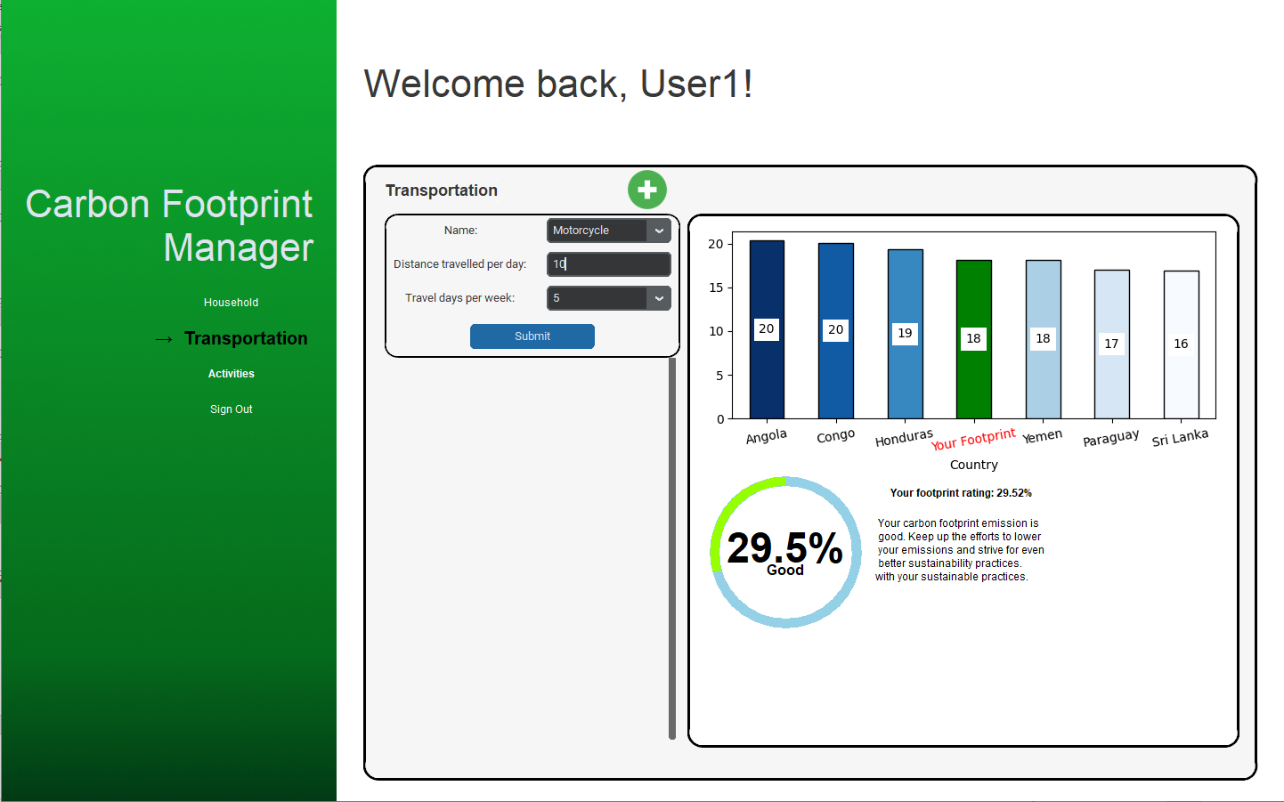

Slide 19
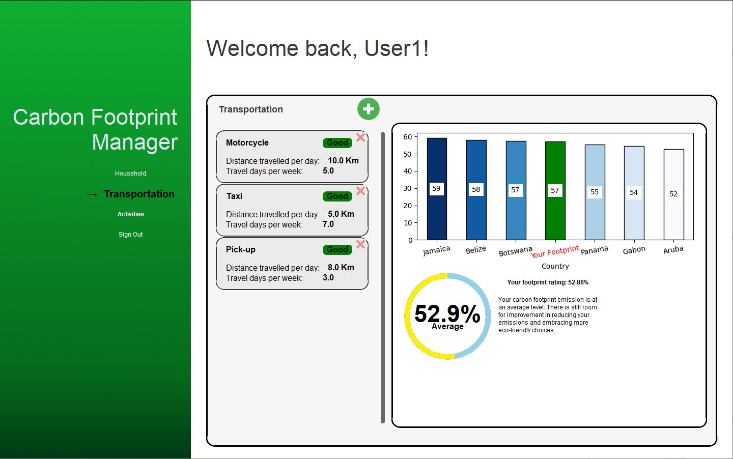

Slide 20
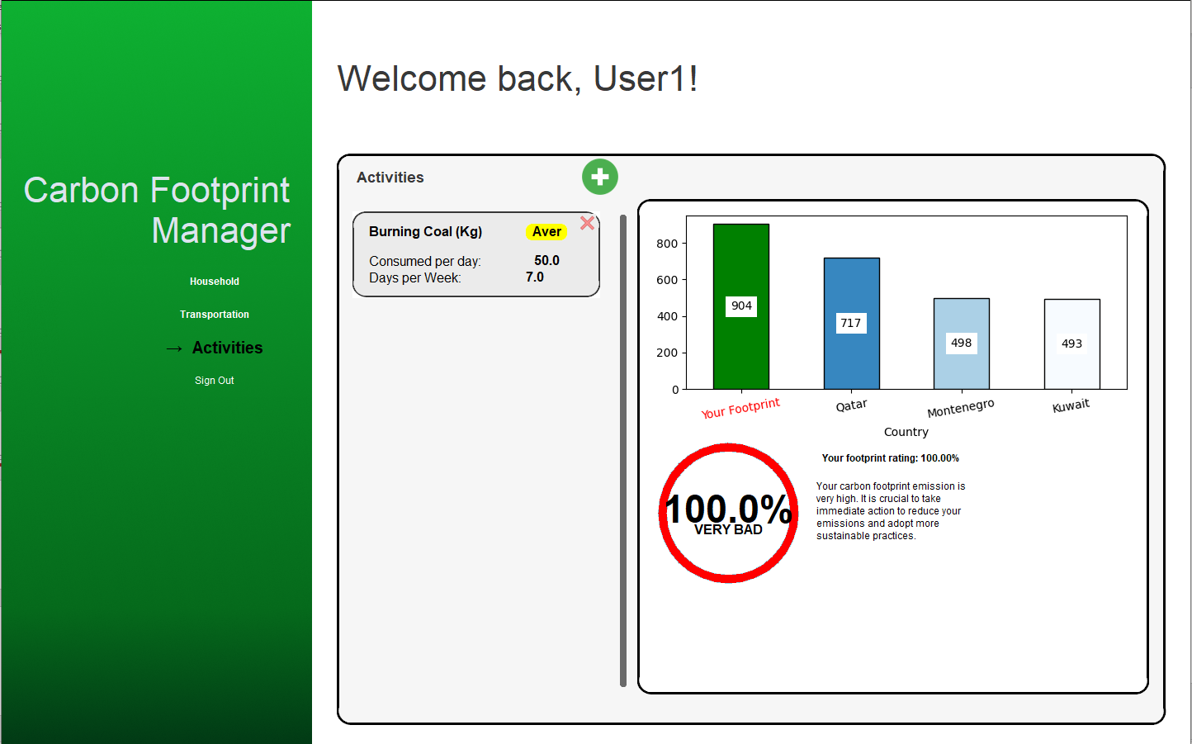

Slide 22
